Slide 1
Milestone 2 Group 1 SEC 101
Gabriele Chiossi, Ben Marschall, Si'raaj Woods

Slide 2
Technology Stack and Tool Chain
We have been using VSCode, Xcode, and Sublime Text to edit all our files. As well as a browser to look at the changes that we put in our code.
We did not use GitHub as much for the last milestone because we did not yet have anything ready to be pushed. We are still learning Java while also implementing it at the same time. When we feel that we have a decent program to be implemented we will push it to our master branch.

Slide 3
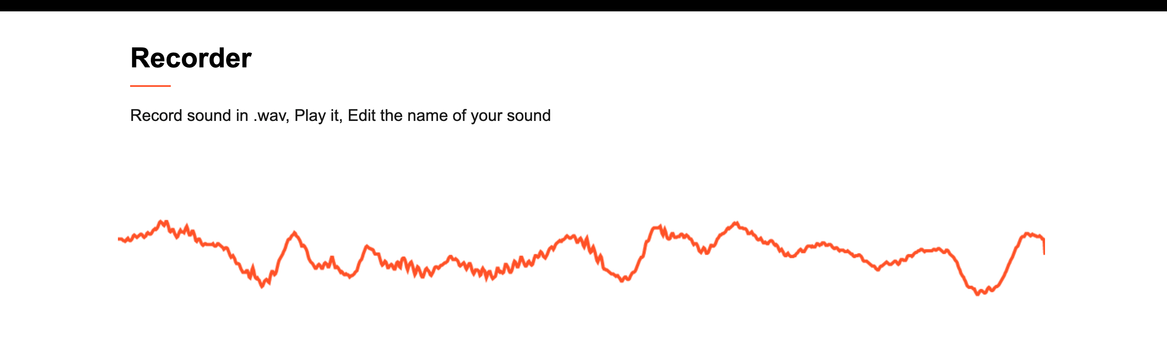
Individual Responsibilities of All Members
Gabriele has been working on the stream for the wave form when recoding. The biggest issue now that he is working on solving is getting the stream of the microphone to turn off when it is not recording. He is focused on getting the wave only to move while an actual recording is taking place. This is our wave form when recording.
Ben, and Si'raaj have been working on getting the music player to work. It is still currently a work in progress, however, once they are able to get it to work than a majority of the project will be complete.

Slide 4
Technology/Device Access of all Members
We have a lot of different technological devices that we have access to. We have been using all of the devices below to get the system to work on multiple platforms.
MACOS
WINDOWS OS
LINUX OS
TEAMS (to comunicate via videocall)
iMessage (to chat daily and update the team)
Browsers: Chrome and Firefox mainly

Slide 5
Definition of the Next Two Milestones
Milestone 3: Have more knowdlege on JavaScript, and have more of the program completed on the music player to implement to our project.
Milestone 4: Finish the actual code together then focus on debugging all of the main issues.

Slide 6
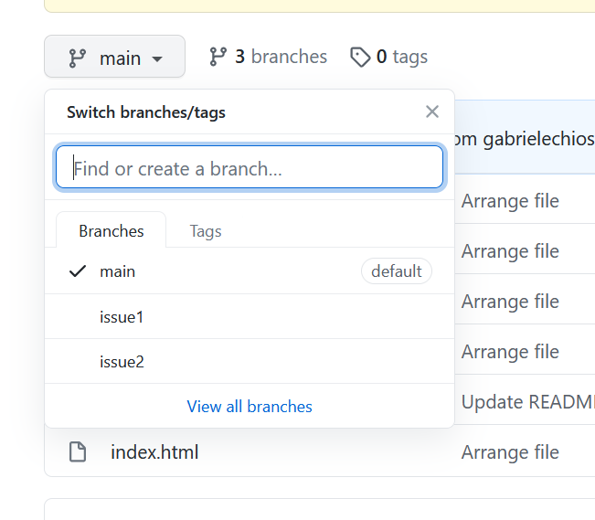
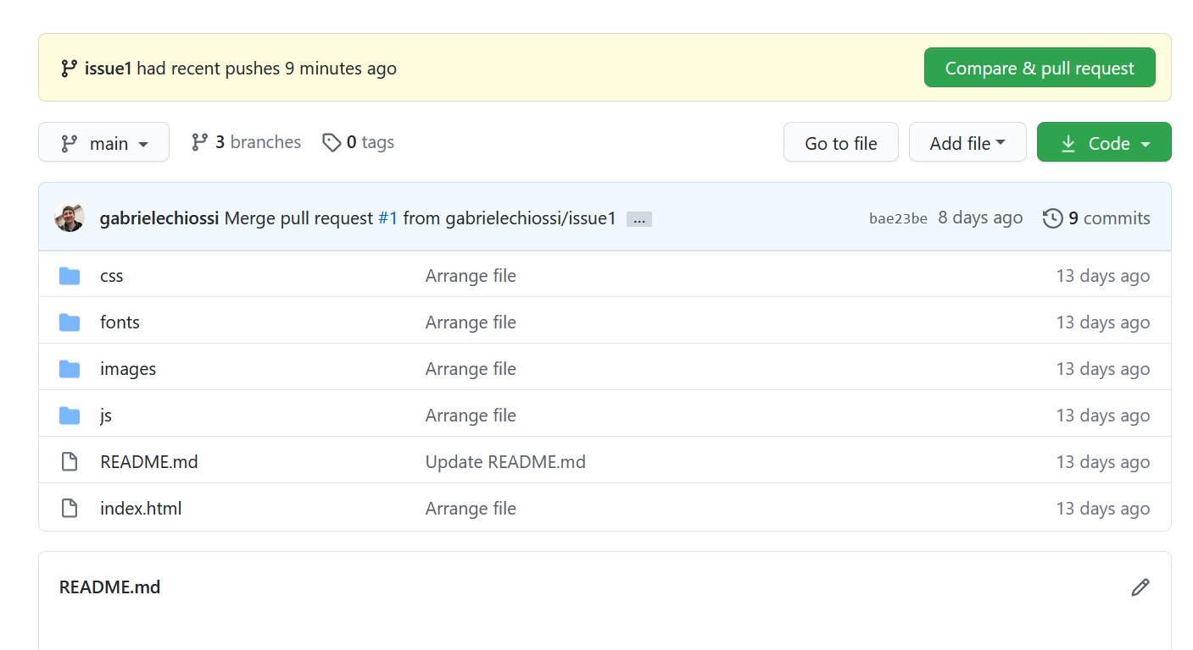
A walk-through of the git repo

Slide 7
Team Communication Plan and Workflow, Including The Two Time Slots For Potential Team Meetings
We communicate very often via text messages for easy communication. However, we also FaceTime and use Microsoft Teams for some of the bigger issues and to keep eachother updated on vital information.
We meet at least twice a week, Tuesday and Thursday night usually after class time, if synchronous, or during class time if asynchronous. We also sometimes meet on the weekends on either Saturdays or Sundays.
Everything that we add we make sure that it works correctly, and have the team agree on it before it is pushed to GitHub.

Slide 8
Difficulties & Setbacks
Despite changing our project after the first milestone and losing a valuable member of our group, we have still made substantial progress overall and are looking forward to showcasing our finished project at the end of the semester.

